Slide 1
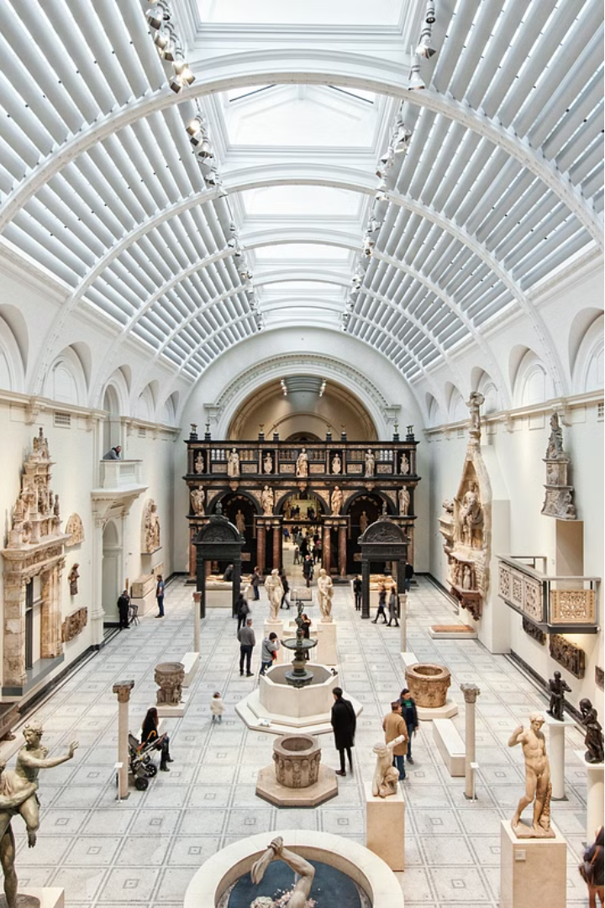
Sanskriti Samvaad: Unveiling Museum Stories with AI
Welcome to the Sanskriti Samvaad! This project aims to bring world culture and history to life through AI-powered conversations in Hindi. Join us on this journey as we explore the hidden stories of museums.

Slide 2
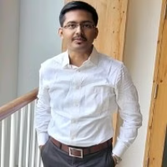
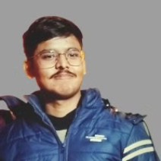
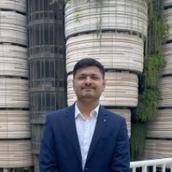


Project Architecture Preview
Project Contributors:
Santanu Satyam Somnath Prithviraj Abhishek
Museum Data
Multilingual sentiment
Soul of the chatbot
The Metropolitan Museum of Art presents over 5,000 years of art from around the world for everyone to experience and enjoy.
Our goal is for the chatbot to converse in multiple languages so that museum stories can be made accessible to international audiences.
This project uses state-of-the-art models such as LLAVA to enable efficient conversations and image context extraction.

Slide 3
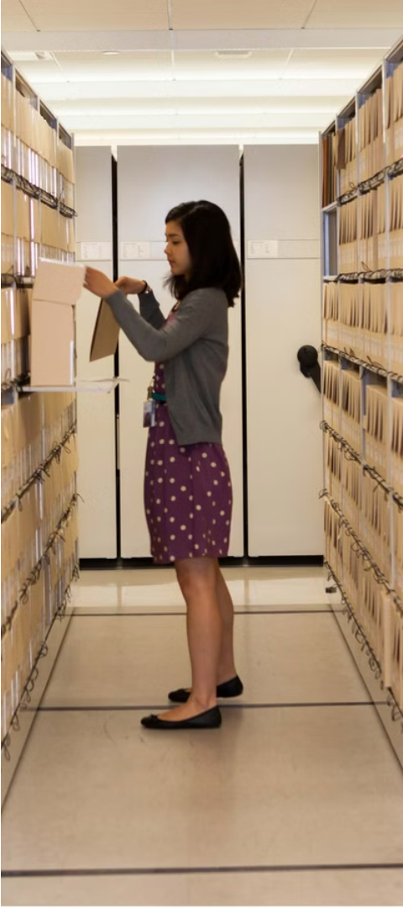
Data Research and Preparation
1
Data Collection
2
Curation and Processing
In the initial phase, we collected a vast database from museums. It included text and images.
The data was cleaned, ensuring accuracy and relevance. This process was crucial.
3
Standardization
The data was organized in a standardized format for effective handling by the chatbot.

Slide 4
The Art of Conversation Building
Question Construction
Answers Extraction
We prepared specific questions to assist viewers in exploring museum stories.
For these questions, we extracted logical and relevant answers from the chatbot model.
Language Processing
Coding Skills
We transformed the data frame into sentences and conversations to make the dialogue more lively.
All these processes are driven by complex coding practices.

Slide 5
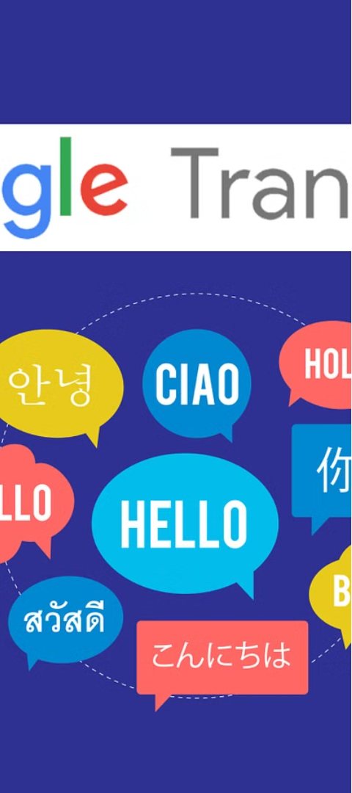


Language Bridge
Translation Challenge
Keeping in mind India's multilingual nature, we tried to solve the translation problem between English & Hindi.
Transformer based Pre-trained Language Translation Model
mBartTokenizer - mBart is a multilingual encoder-decoder (sequence-to-sequence) model primarily intended for translation task.

Slide 6

Success Stories of Translation
1
Evaluation of Capability
We conducted a comprehensive evaluation of the translation model's performance and accuracy. Used METEOR for translation model evaluation.
2
Creation of Language Bridge
We integrated code modules in such a way that they formed a bridge between languages.
3
Freedom of Communication
As a result, viewers can enjoy museum stories without any language barriers.

Slide 7
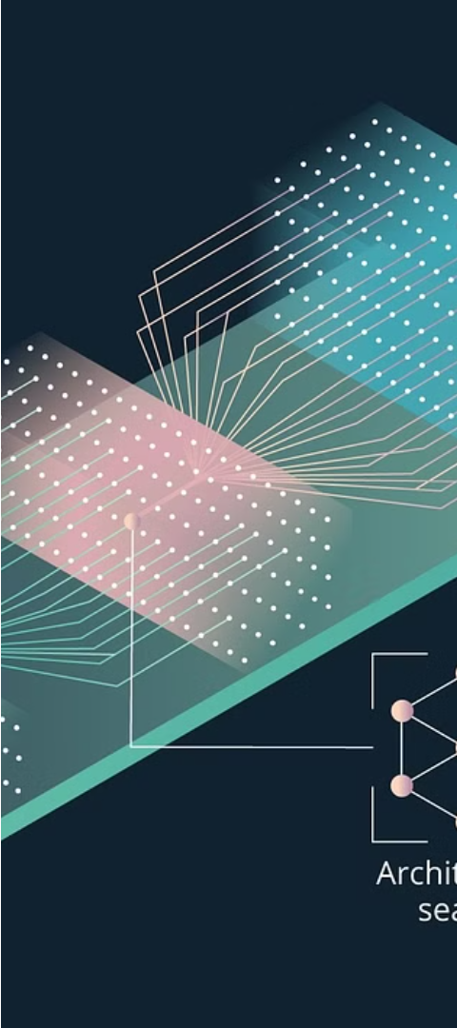
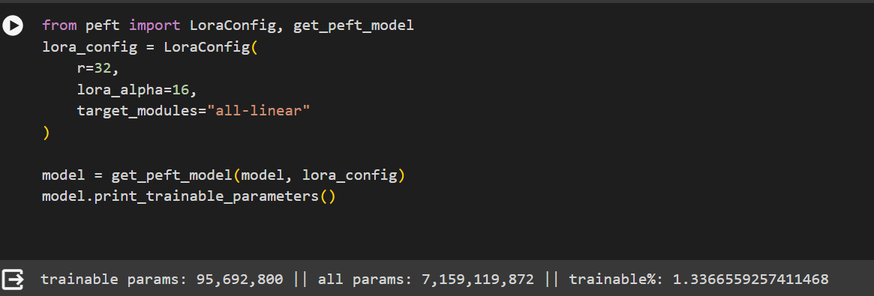
Development of Intelligence
1
LLAVA Model
LORA Adapter
2
We used the LLAVA model, which performs exceptionally well in Image and Text .
By using the LORA adapter, we customized the original model and enhanced its capabilities.

Slide 8
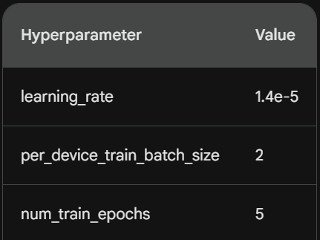
1
Hyper-parameters

Slide 9
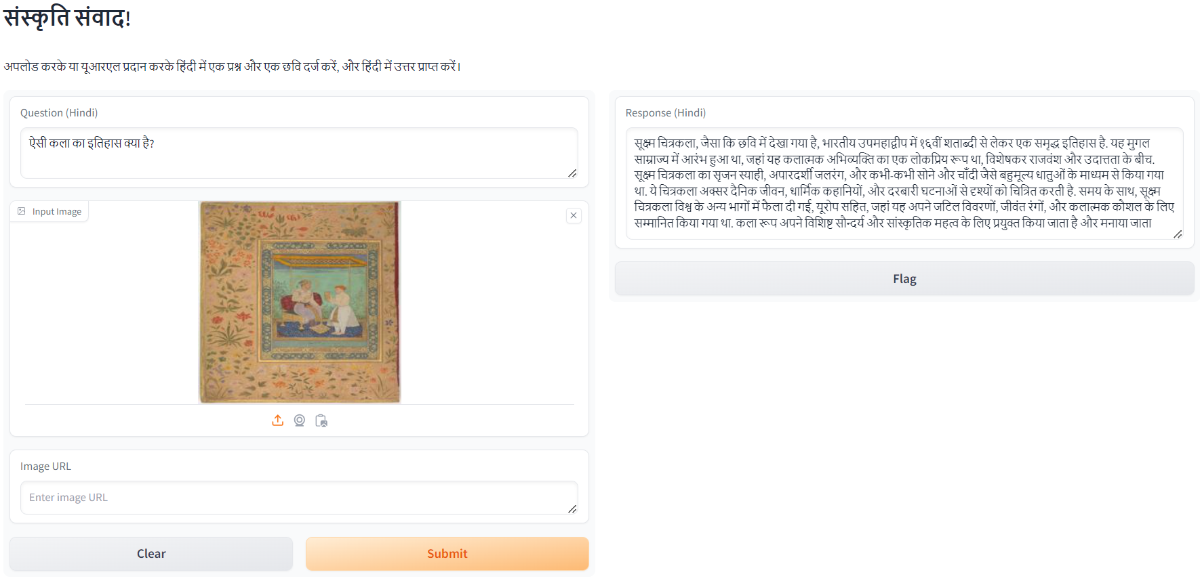
The Emergence of Oracle
Providing Question
Uploading Image
Dissemination of Knowledge
The chatbot takes questions as input from user which to be answered later from image input.
Provision available for uploading the image as well as giving input as URL of the image.
The chatbot comprehensively explains various museum narratives using images and text.

Slide 10
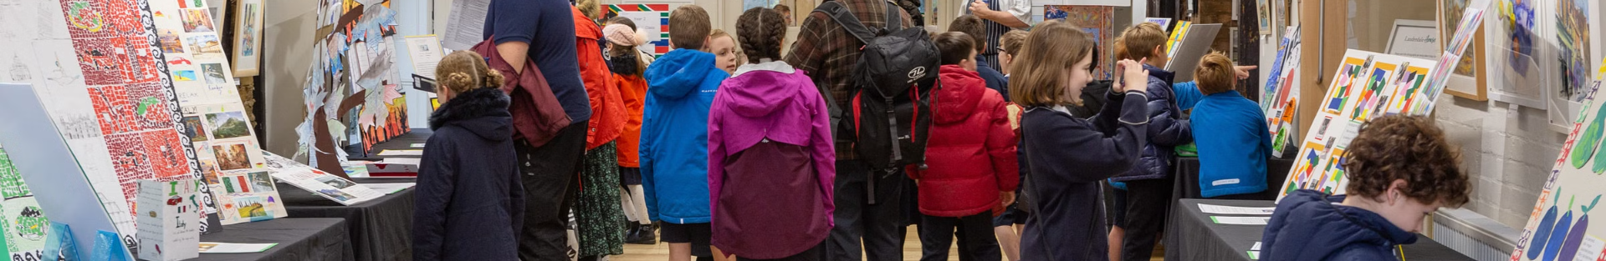
Conclusion
Summary of the Journey
1
We have successfully brought museum stories to life through the medium of cultural dialogue.
2
Learnings and Achievements
In this journey, we have gained several important learnings and achieved excellent accomplishments.
Future Direction
3
We hope that this project will expand and progress further in the future and provide people with a deep understanding of culture.

